Slide 1





UofT Computer Vision Club
Paper Breakdown Series
PointNet: Deep Learning on Point Sets for 3D Classification and Segmentation
Follow us on social media
youtube.com/@uoftcv
github.com/ut-cvdg/paper-breakdown

Slide 2






UofT CV is sponsored by
Sign up for the GitHub Student Developer Pack:
https://education.github.com/benefits

Slide 3
About the Club
We are a student club for Computer Vision and Machine Learning affiliated with the University of Toronto.
We run:
paper “discussions” for paper in the past 1 week
conference-style research orals for pre-prints
Now, paper breakdown series
If you want to help run our club, talk to any of us or drop an email contact@cvdg.tech.

Slide 4
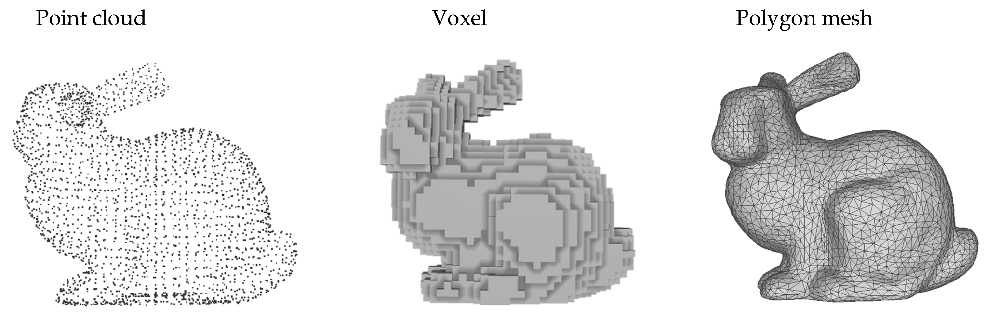
Point Clouds

Slide 5
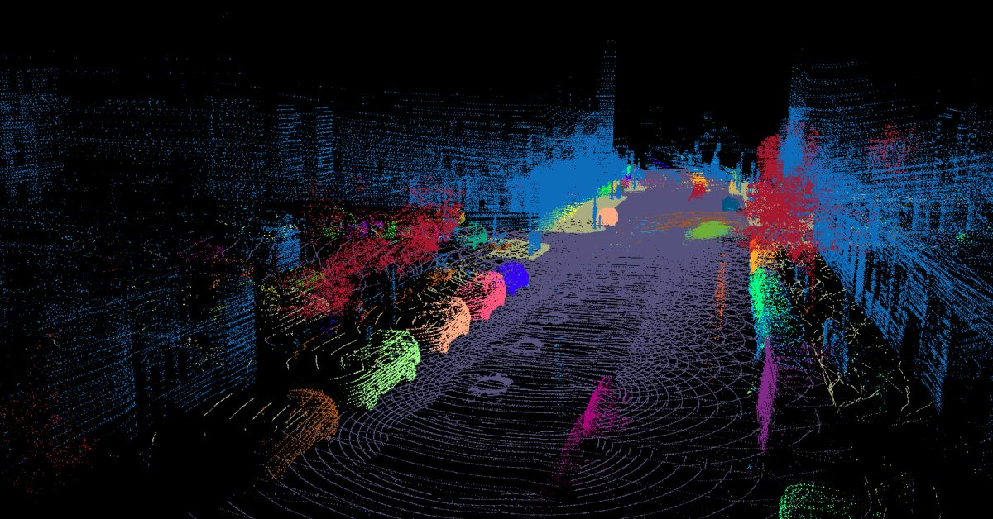
Point Clouds

Slide 6
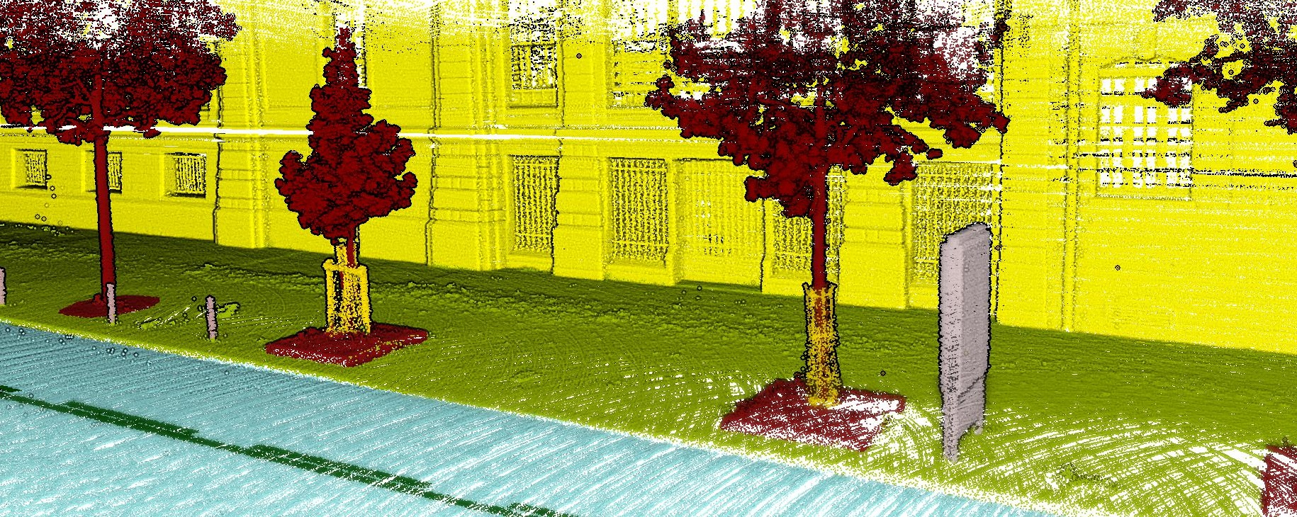
Learning with Point Clouds

Slide 7
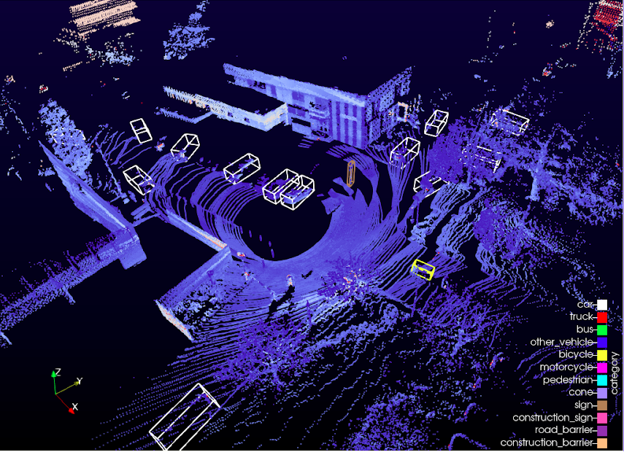
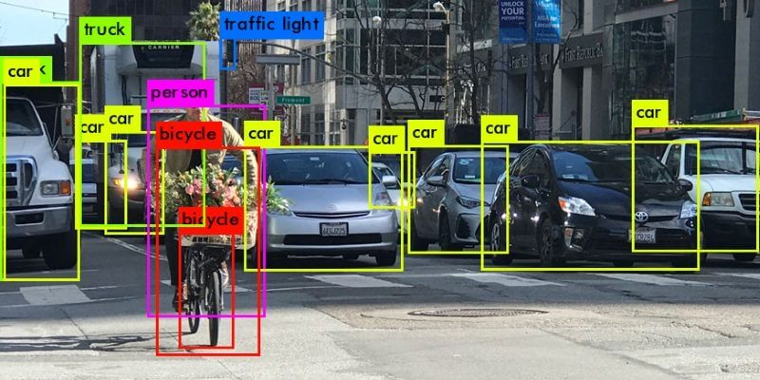
Learning with Point Clouds

Slide 8
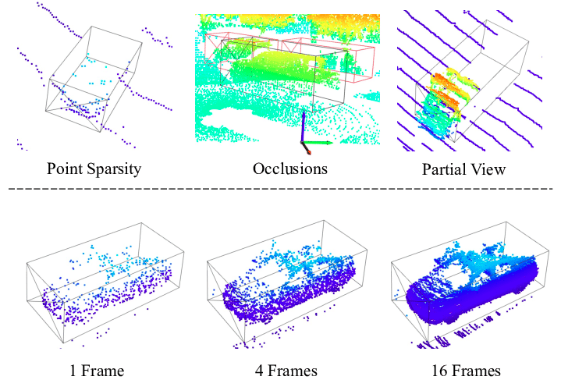
Learning with Point Clouds

Slide 9
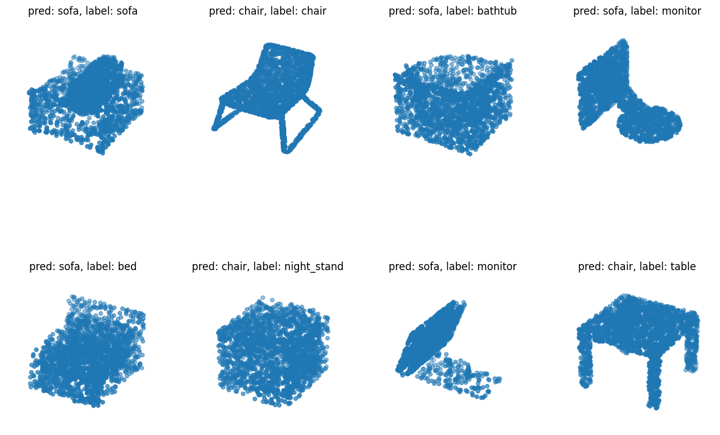
A Simple Problem: Object Classification

Slide 10
What properties should our learned function have?

Slide 11
Hint

Slide 12
Do actions change semantics?

Slide 13
Do actions change semantics?

Slide 14
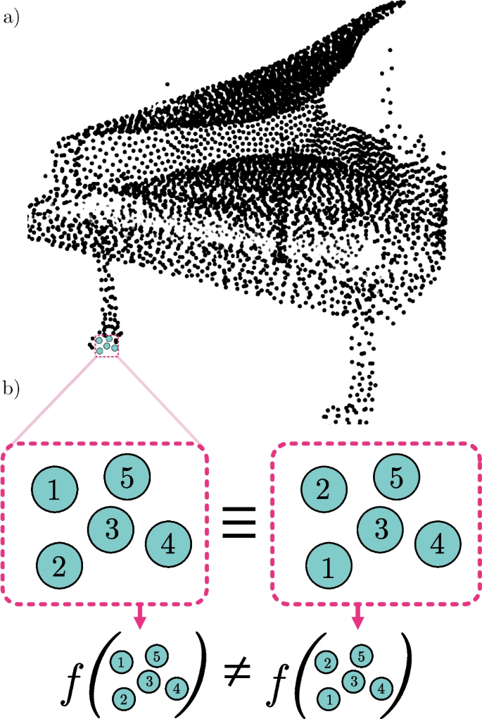
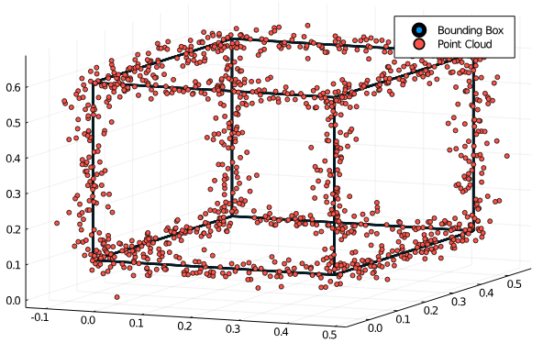
Potential Desirable Symmetries
SO(3) (rotations)
T(3) (translations)
O(3) (rotations + reflections)
Scale invariance
Permutation invariance
etc.
Some invariance to noise would also be nice — more on this later

Slide 15
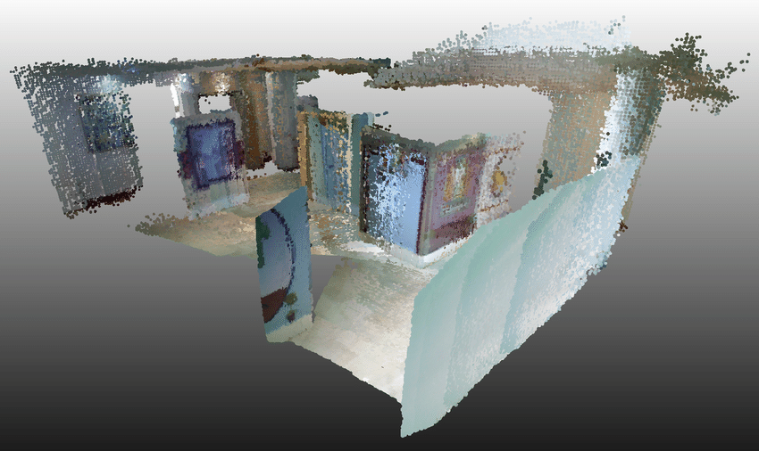
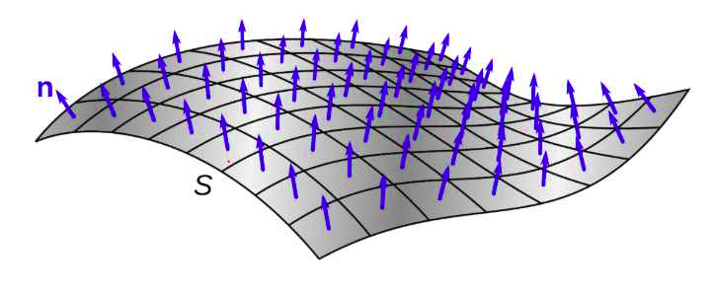
Point Representations
“In the basic setting each point is represented by just its three coordinates (x, y, z). Additional dimensions may be added by computing normals and other local or global features”

Slide 16
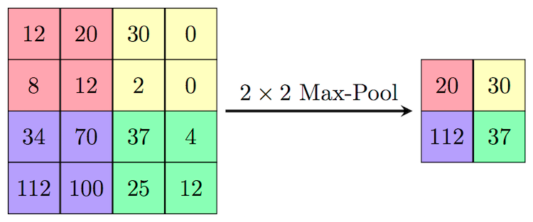
“Key to our approach is the use of a single symmetric function, max pooling.”
“We show that our network can approximate any set function that is continuous.” — do these two statements contradict each other?

Slide 17
Problem statement
“For the object classification task, the input point cloud is either directly sampled from a shape or pre-segmented from a scene point cloud. Our proposed deep network outputs k scores for all the k candidate classes. For semantic segmentation, the input can be a single object for part region segmentation, or a sub-volume from a 3D scene for object region segmentation. Our model will output n × m scores for each of the n points and each of the m semantic sub-categories.”

Slide 18
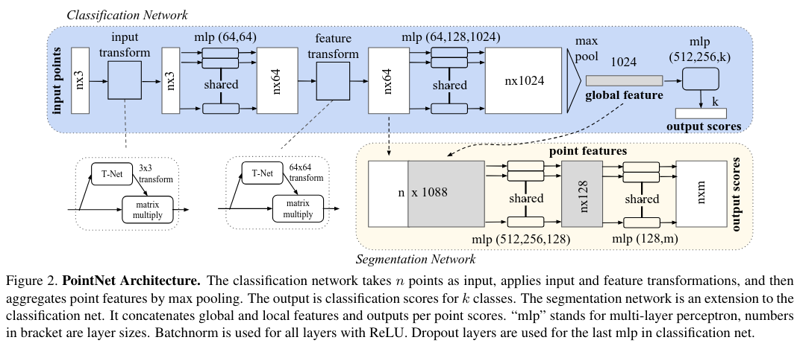
Architecture

Slide 19
Architecture
“Our network has three key modules: the max pooling layer as a symmetric function to aggregate information from all the points, a local and global information combination structure, and two joint alignment networks that align both input points and point features.”

Slide 20
Architecture: Permutation Invariance
Options proposed in the paper:
Sorting input into a canonical order
Train on multiple permutations of the same point cloud or pipeline with another model that learns this invariance implicitly
Use a symmetric function to aggregate n input vectors into a single vector invariance to input permutations

Slide 21
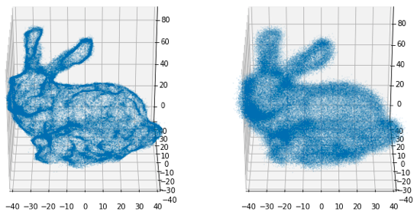
Architecture: Permutation Invariance
Options proposed in the paper:
Sorting input into a canonical order
Complicates point perturbation stability in high-dimensional spaces
Train on multiple permutations of the same point cloud or pipeline with another model that learns this invariance implicitly
Use a symmetric function to aggregate n input vectors into a single vector invariance to input permutations

Slide 22
Architecture: Permutation Invariance
Options proposed in the paper:
Sorting input into a canonical order
Complicates point perturbation stability in high-dimensional spaces
Train on multiple permutations of the same point cloud or pipeline with another model that learns this invariance implicitly
Blows up with sequence length
Use a symmetric function to aggregate n input vectors into a single vector invariance to input permutations

Slide 23
Architecture: Permutation Invariance
Options proposed in the paper:
Sorting input into a canonical order
Complicates point perturbation stability in high-dimensional spaces
Train on multiple permutations of the same point cloud or pipeline with another model that learns this invariance implicitly
Blows up with sequence length
Use a symmetric function to aggregate n input vectors into a single vector invariance to input permutations
Approach taken in the paper
How much information do we lose upon aggregation?

Slide 24
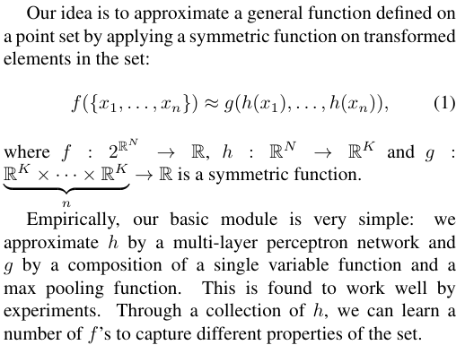
Architecture

Slide 25
Architecture
Apply an affine transformation given by output from a “T-Net”

Slide 26
Architecture
Apply a MLP pointwise

Slide 27
Architecture
Apply another an affine transformation given by output from a “T-Net”

Slide 28
Architecture: Classification
Apply an MLP pointwise

Slide 29
Architecture: Classification
Representation up to here
affine dependent on input -> fixed pointwise MLP -> affine dependent on input -> fixed Pointwise MLP

Slide 30
Architecture: Classification
Symmetric aggregation

Slide 31
Architecture: Classification
k-dimensional classification output

Slide 32
Architecture: Classification

Slide 33
Architecture: Classification
h
g?

Slide 34
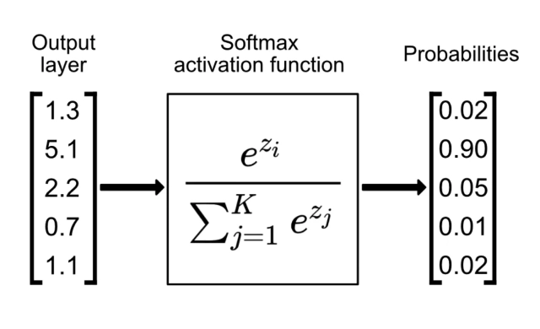
Architecture: Classification
g?

Slide 35
Architecture: Classification
It is g!

Slide 36
Architecture: Classification
h
g
Symmetries from earlier:
SO(3) (rotations)
T(3) (translations)
O(3) (rotations + reflections)
Scale invariance
Permutation invariance

Slide 37
Architecture: Classification
h
g
Symmetries from earlier:
SO(3) (rotations)
T(3) (translations)
O(3) (rotations + reflections)
Scale invariance
Permutation invariance

Slide 38
Architecture: Classification
h
g
Symmetries from earlier:
SO(3) (rotations)
No
T(3) (translations)
O(3) (rotations + reflections)
Scale invariance
Permutation invariance

Slide 39
Architecture: Classification
h
g
Symmetries from earlier:
SO(3) (rotations)
No
T(3) (translations)
O(3) (rotations + reflections)
Scale invariance
Permutation invariance

Slide 40
Architecture: Classification
h
g
Symmetries from earlier:
SO(3) (rotations)
No
T(3) (translations)
No
O(3) (rotations + reflections)
No
Scale invariance
No
Permutation invariance

Slide 41
Architecture: Classification
h
g
Symmetries from earlier:
SO(3) (rotations)
No
T(3) (translations)
No
O(3) (rotations + reflections)
No
Scale invariance
No
Permutation invariance
Yes, if both T-Nets are

Slide 42
Architecture: Classification
Symmetries from earlier:
SO(3) (rotations)
No
T(3) (translations)
No
O(3) (rotations + reflections)
No
Scale invariance
No
Permutation invariance
Yes, if both T-Nets are
So, why go to all this trouble?

Slide 43
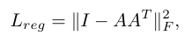
Architecture: Classification
O(3) (rotations + reflections)
No
Scale invariance
No
Permutation invariance
Yes, if both T-Nets are
Symmetries from earlier:
SO(3) (rotations)
No
T(3) (translations)
No
Add regularization terms to encourage the Orthogonal transformations

Slide 44
Architecture: Classification
O(3) (rotations + reflections)
Tricks
Scale invariance
No
Permutation invariance
Yes, if both T-Nets are
Symmetries from earlier:
SO(3) (rotations)
Tricks
T(3) (translations)
No
Add regularization terms to encourage the Orthogonal transformations — terms in loss are jointly minimized if representations are normalized by a rotation

Slide 45
Architecture: Classification
“Universal approximation We first show the universal approximation ability of our neural network to continuous set functions. By the continuity of set functions, intuitively, a small perturbation to the input point set should not greatly change the function values, such as classification or segmentation scores”
Noise invariance:
Slight perturbations of points shouldn’t affect classification
Outlier points shouldn’t affect classification

Slide 46
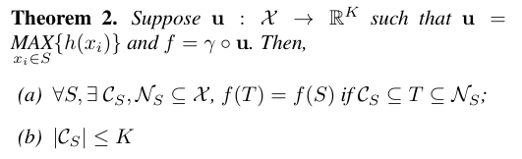
Architecture: Classification
Noise invariance:
Slight perturbations of points shouldn’t affect classification
Outlier points shouldn’t affect classification
For any set of inputs S, there exists sets of inputs A, B such that the image our of model under S is equal to the image of out model under T for any T “between” A and B. This:
Tells us max pooling has a huge affect on expressiveness
Tells us that if we design our network up to max pooling to be robust against (possibly very small) perturbations, our output will be

Slide 47
Food for thought

Slide 48

Food for thought
Can we do better than aggregation?
How can we attend to other points?
Do this in the T-Net portions?
Try a new architecture?

Slide 49
Food for thought
Are there any invariances we missed?
How might we tackle sparsity or partial observations?
Which problems should be solved with hardware and which with software/our learning algorithm?

Slide 50
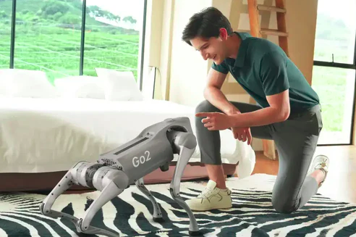
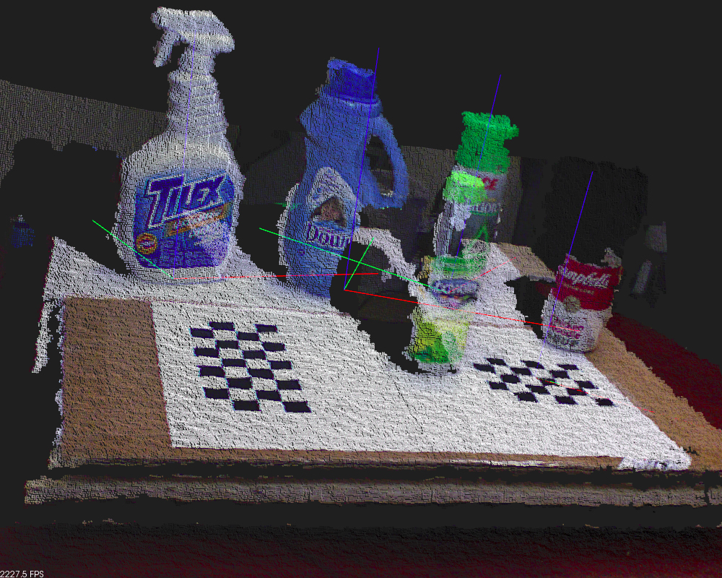
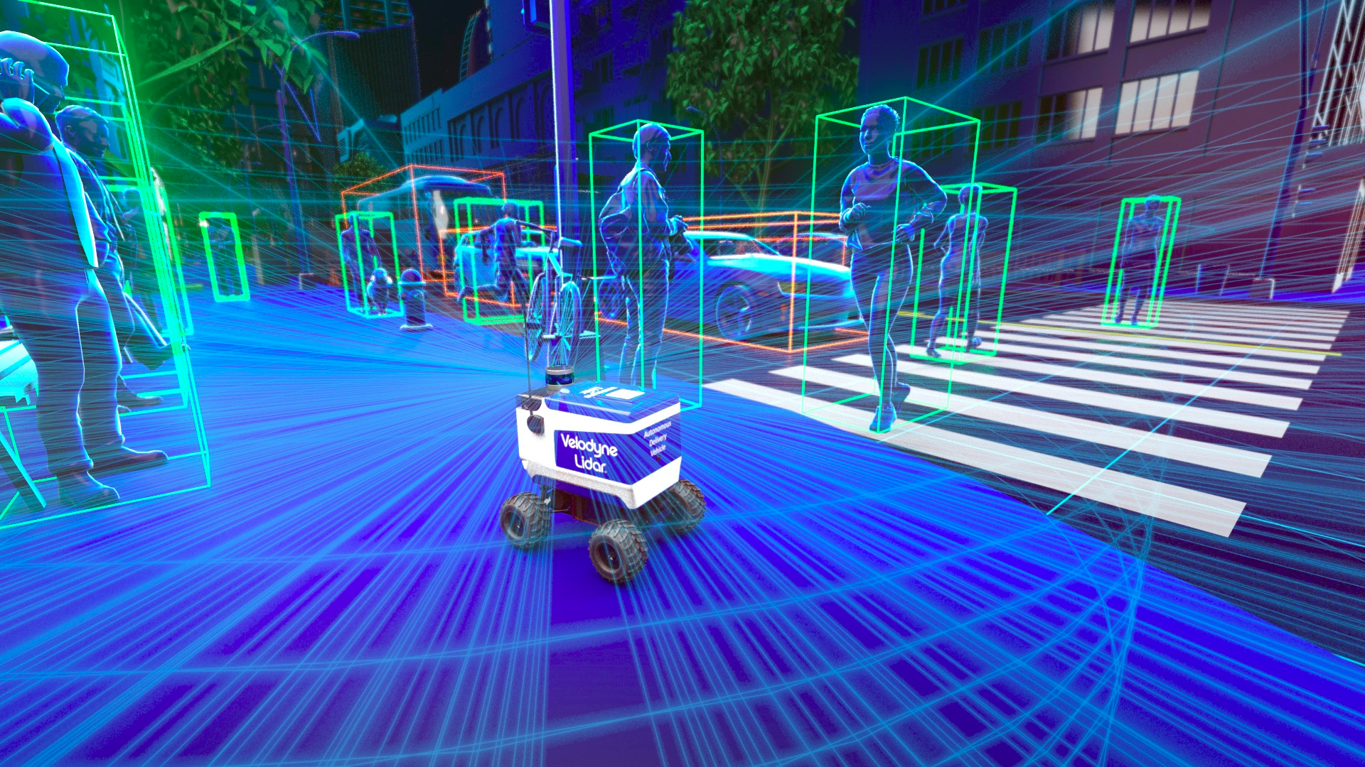
Slides on
github.com/ut-cvdg/paper-breakdown
Thanks!
Follow us on social media

